Slide 1

HS3052 Capstone Project Design: Supplementary Document
Supervisor: Dr. Farshid Keivanian
Session 4: Preparation for Group Assignment 4 (Solution Prototype)

Slide 2
Session 4’s Outline
Weekly Task Breakdown & Milestones
Preparation for Group Assignment 4 – Solution Prototype
Group Progress Presentation – Overview of Progress at least 2 min

Slide 3
Weekly Task Breakdown & Milestones
Week | Tasks | Notes
1 | Finalise group & select topic | Choose from topics like Library Mgmt, Lost & Found, Feedback System, etc.
2 | Project Management Package (Assessment 1 due) | Scope, charter, WBS, Gantt chart – submit as a group
3–4 | Requirements analysis + Literature review | Collect references, interview users, gather data, start drafting RS
5 | Presentation of proposed solution (Assessment 2) | Slides + demo/mockup preview
6 | Submit Requirements Specification (Assessment 3) | System overview, diagrams, user stories, use cases, ERD, schema
7 | Prototype building begins | Setup tools, split coding and UI/UX tasks among group

Slide 4
Weekly Task Breakdown & Milestones
Week | Tasks | Notes
8–11 | Development + testing | Complete features, peer review, fix bugs, update documents
12 | Submit Final Prototype + Docs (Assessment 4) | Include testing report, user manual, installation guide, project closure plan

Slide 5
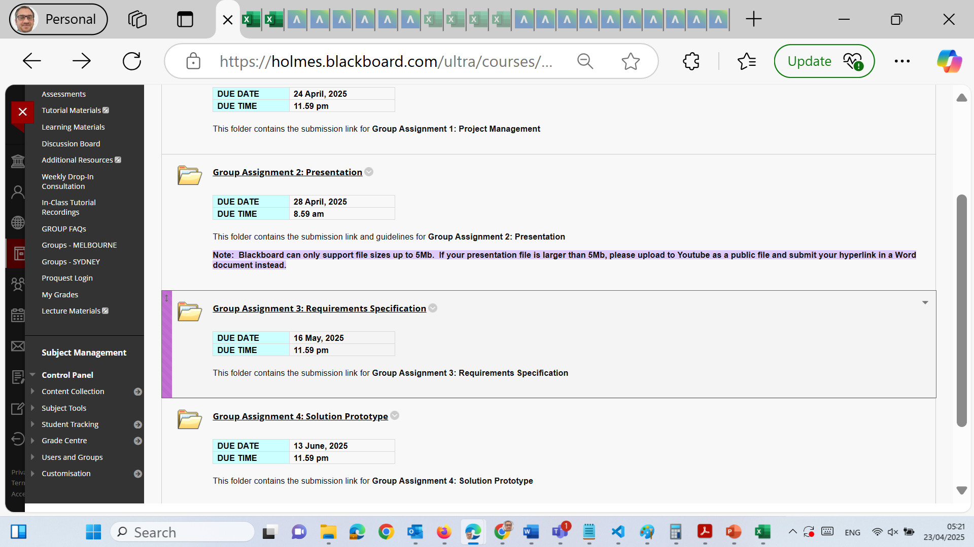
Preparation for Group Assignment 4: Solution Prototype

Slide 6
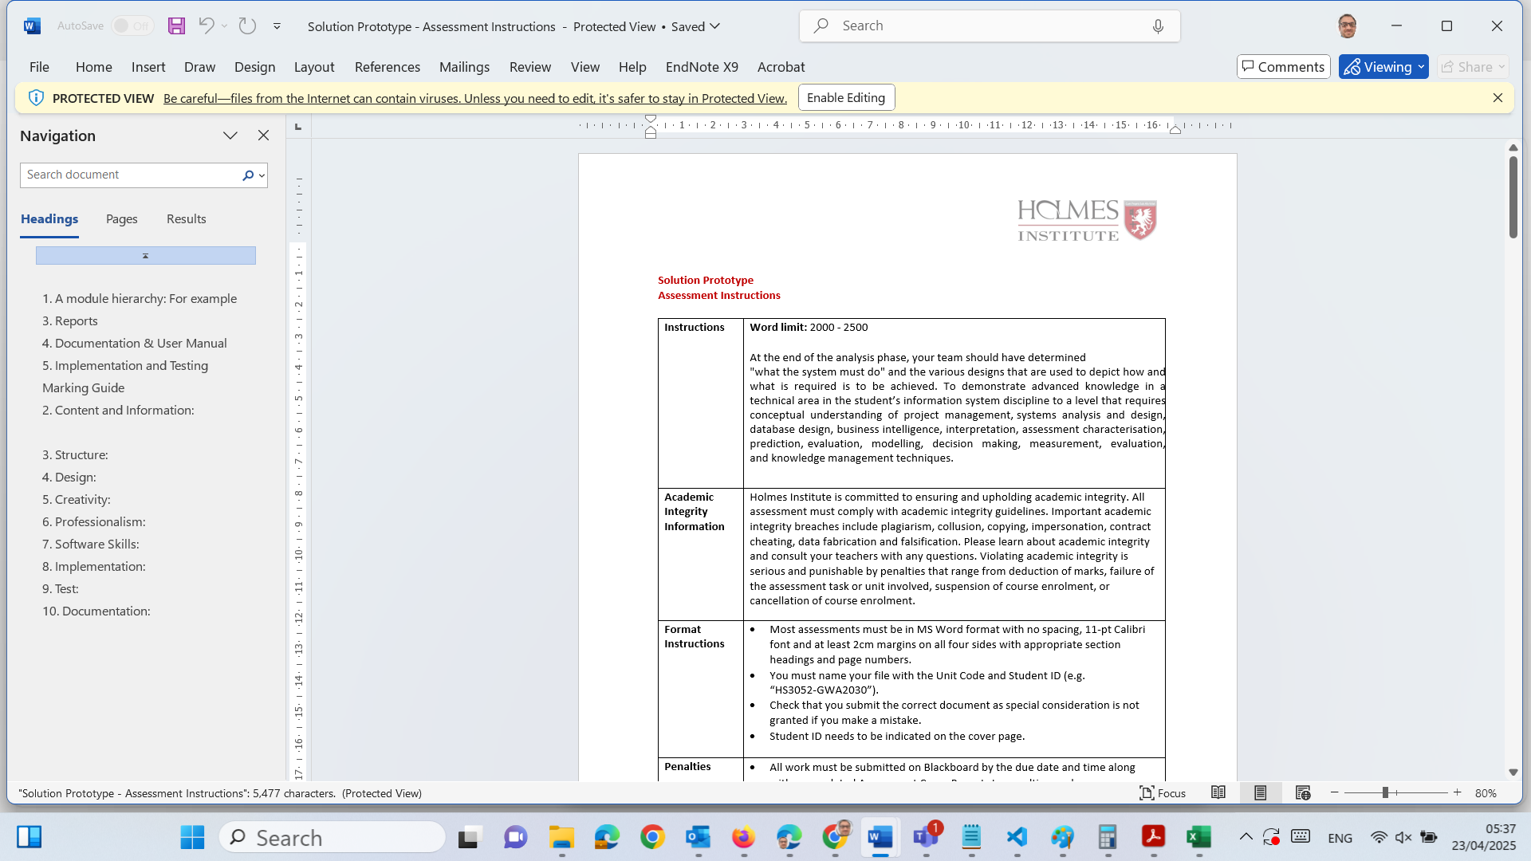
Preparation for Group Assignment 4: Solution Prototype

Slide 7
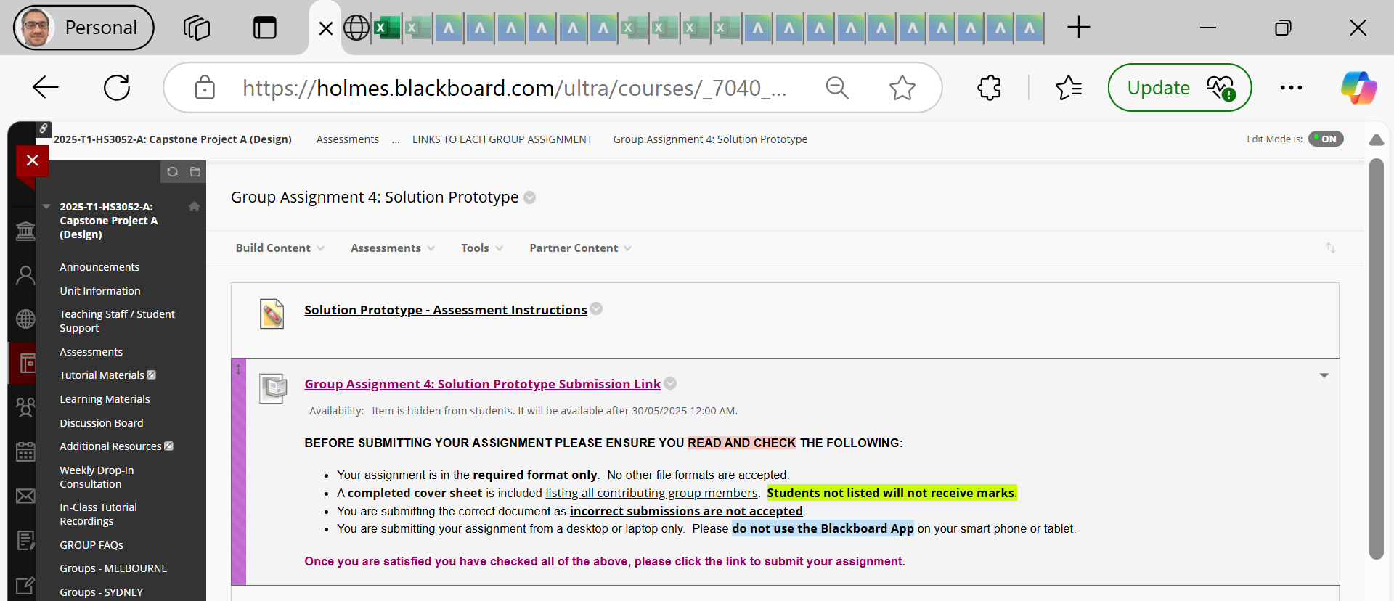
Preparation for Group Assignment 4: Solution Prototype

Slide 8
Preparation for Group Assignment 4: Solution Prototype
Word Limit: 2000–2500 words Weight: 30%

Slide 9
Preparation for Group Assignment 4: Solution Prototype
Purpose of the Assignment:
This assignment allows your team to present a working prototype of your proposed system. You will showcase the design, functionality, and implementation strategy, demonstrating practical application of your technical and analytical skills.
Your submission should demonstrate:
Technical competency in building and designing software interfaces.
Clear understanding of the requirements outlined in Assignment 3.
Thoughtful system architecture, functionality, usability, and real-world viability

Slide 10
Preparation for Group Assignment 4: Solution Prototype
Required Components
1. Module Hierarchy (3%)
Display a diagram showing the system’s structure.
Use a tree or chart format (e.g., Admin > User Management > Add User, Edit User, etc.).
Clearly define modules, submodules, and their interactions.

Slide 11
Preparation for Group Assignment 4: Solution Prototype
2. Mock-up Screens (5%)
Include annotated mock-ups of important system interfaces.
Screens should show layout, font, color, and button placement.
Tools: You can use Figma, Adobe XD, Balsamiq, or simply annotated PowerPoint slides.
Tip: Group similar interfaces together and explain reusable design elements.

Slide 12
Preparation for Group Assignment 4: Solution Prototype
3. Reports (6%)
Define what business reports your system can generate (e.g., User Activity Report, Monthly Sales Summary).
Provide sample report layouts: show headings, data tables, filters, and formats.

Slide 13
Preparation for Group Assignment 4: Solution Prototype
4. Documentation & User Manual (6%)
Your documentation should be usable and informative for new users:
Interface text: Instructions, menus, tooltips, error messages.
Operational messages: Error handling and warnings.
Online help: FAQs, tutorials, navigation tips.
Printable User Manual: Describe steps for login, task execution, troubleshooting.
Hint: Include screenshots with annotated steps to guide usage.

Slide 14
Preparation for Group Assignment 4: Solution Prototype
5. Implementation & Testing (10%)
Explain how your system is built: which tools, technologies, and how modules are connected.
Include:
Screenshots of your working prototype.
Technology stack used (e.g., XAMPP + PHP + MySQL + HTML/CSS/JS).
Brief database structure.
Testing strategy: Describe unit, integration, and user testing conducted. Mention test results and any known bugs/fixes.

Slide 15
Preparation for Group Assignment 4: Solution Prototype
Tips for Success
What To Do:
Organize content logically: Introduction → Design → Implementation → Testing.
Use diagrams for clarity (Gantt chart, mockups, architecture, etc.).
Clearly label and caption all images and diagrams.
Write in clear professional language suitable for a business and technical audience.
Follow formatting guidelines: Calibri 11pt, 2cm margins, appropriate headings.

Slide 16
Preparation for Group Assignment 4: Solution Prototype
❌ What to Avoid:
Submitting screenshots with no explanation.
Omitting your group number or student names from the cover sheet.
Using technical jargon without context.
Missing citation of tools, libraries, or borrowed resources.

Slide 17
Preparation for Group Assignment 4: Solution Prototype
Submission Requirements
Format: MS Word (.docx)
Filename: HS3052-StudentID.docx
Include: Assessment Cover Page with all group members listed
Submit via Blackboard by (refer to blackboard for the due date)

Slide 18
Preparation for Group Assignment 4: Solution Prototype
Marking Guide (30% Total)
Criteria | Weight
Module Hierarchy | 3%
Mock-up Screens | 5%
Reports | 6%
Documentation & User Manual | 6%
Implementation & Testing | 10%

Slide 19
Preparation for Group Assignment 4: Solution Prototype
Suggested Tools
Design/Mockups: Figma, Balsamiq, Adobe XD, PowerPoint
Development: XAMPP, PHP, MySQL, HTML, CSS, JS
Reporting: Excel, Power BI, Google Data Studio
Documentation: MS Word, Google Docs

Slide 20
Preparation for Group Assignment 4: Solution Prototype
Academic Integrity Reminder
Strict penalties apply for:
Plagiarism
Contract cheating
Collusion
Submission impersonation
Always produce original work and credit all sources using Holmes Adapted Harvard Referencing.

Slide 21
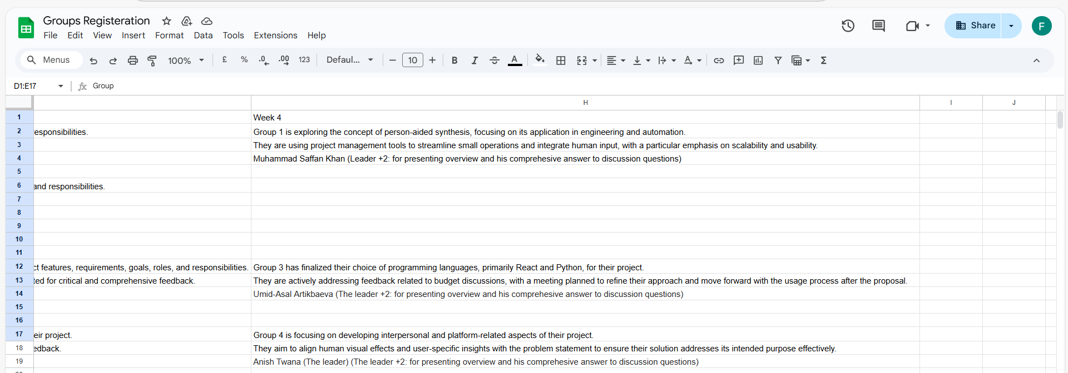
Group Progress Presentation – Overview of Progress at least 2 min

Slide 22
Thank You
Need Help? Send an email or ask during the tutorial session.
Good luck with your capstone journey!
Dr. Farshid Keivanian Capstone Project Supervisor farshid.keivanian@holmes.edu.au

